Slide 1
Ensuring High Availability and Scalability for Monolithic Applications
Virtualization and Cloud Computing Project Submission
Vidyut Bhaskar (G23AI2128)
Rahul Verma (G23AI2039)
Atul Singh (G23AI2104)

Slide 2
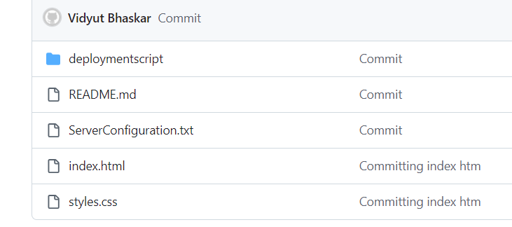
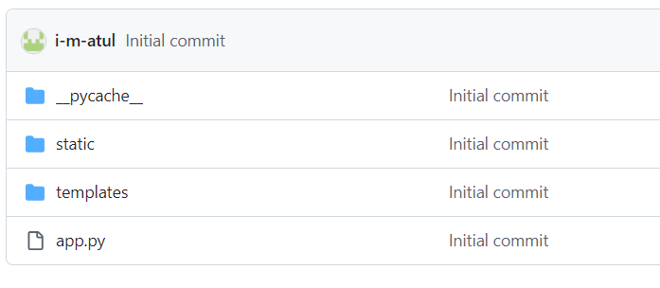
Project Artifacts
https://github.com/DSvidyutbhaskariitj/VCC_PROJECT.git
https://github.com/i-m-atul/VCC_Assignment-3.git
Scripts and Test App
App Code

Slide 3
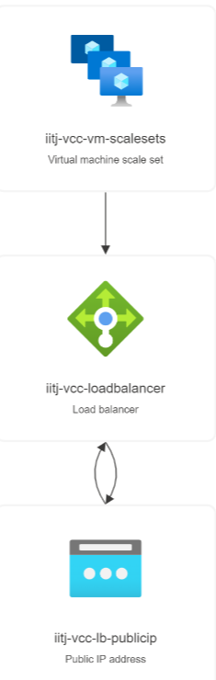
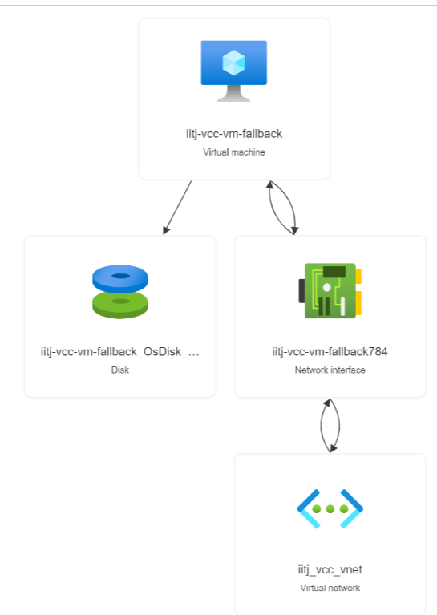
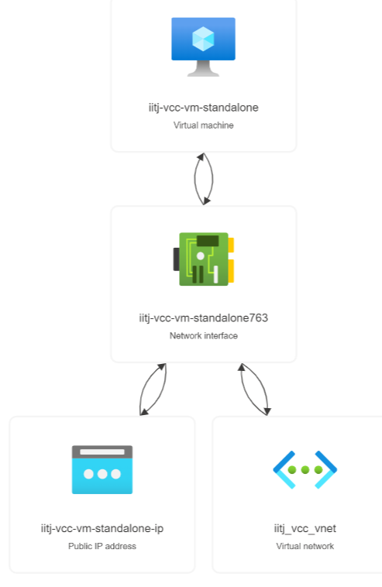
Resource Group Visualizer

Slide 4
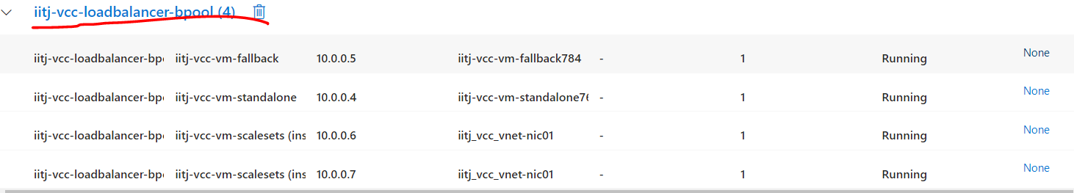
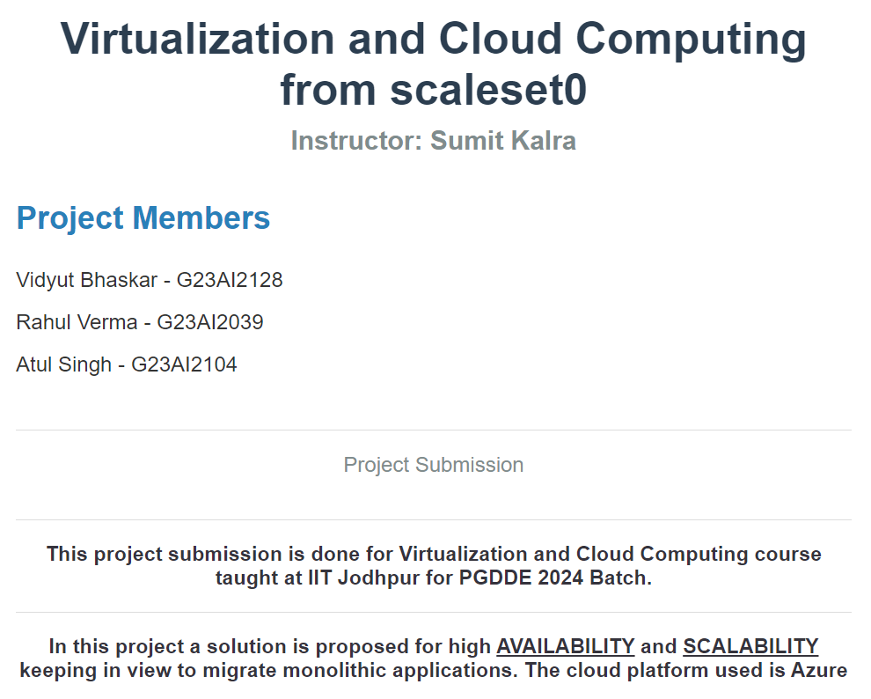
Optimum Running Scenario – All resources Running

Slide 5
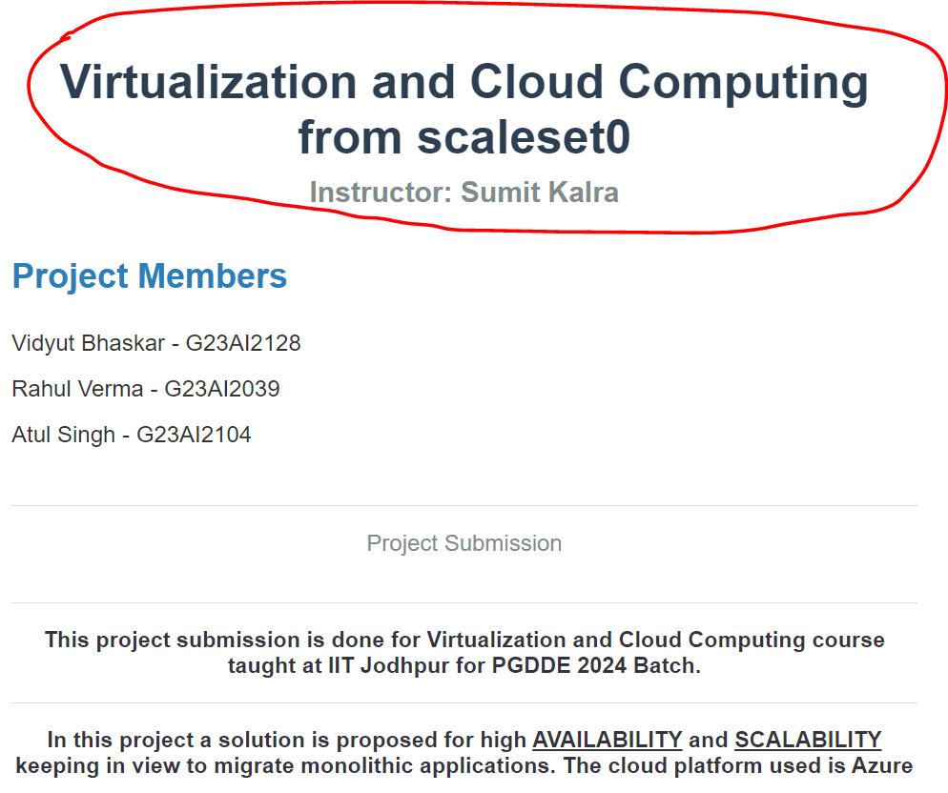
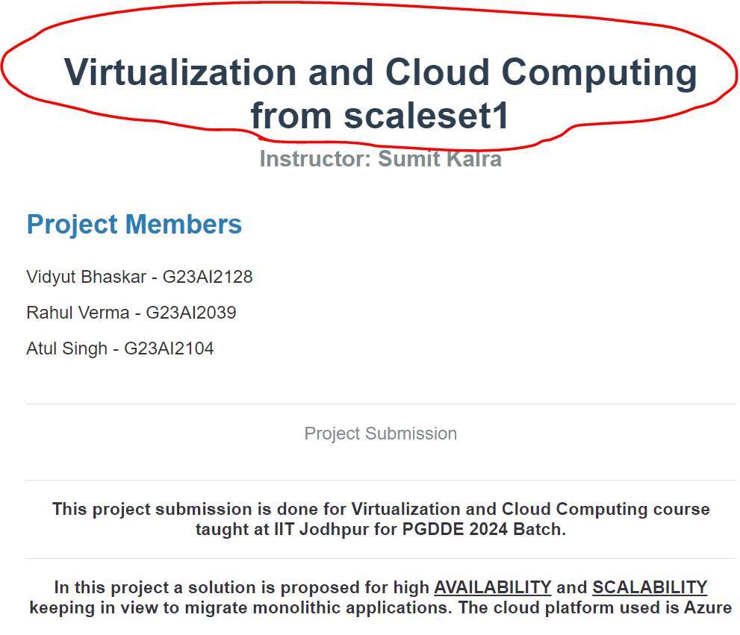
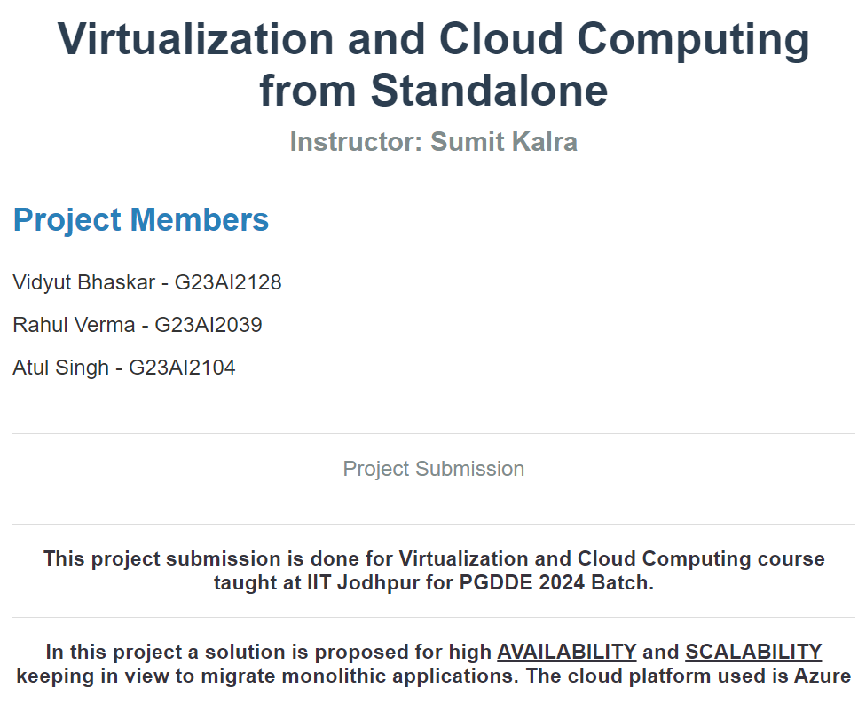
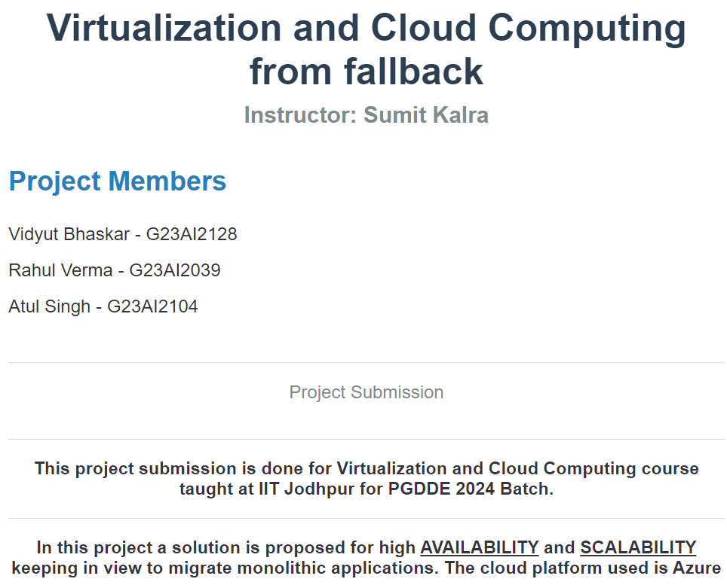
Simulation of Application availability in case of Downtime
Running Resource
iitj-vcc-vm-scalesets_0
Running Resource
iitj-vcc-vm-scalesets_1
Running Resource
iitj-vcc-vm-standalone
Running Resource
iitj-vcc-vm-fallback
This Ensures that the Application is in running stage in any case even when the multiple VMs are having downtime.

Slide 6
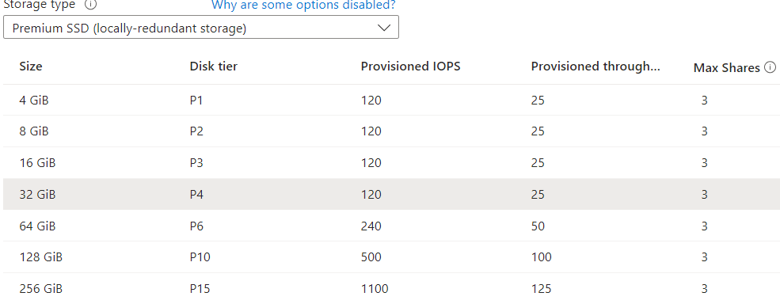
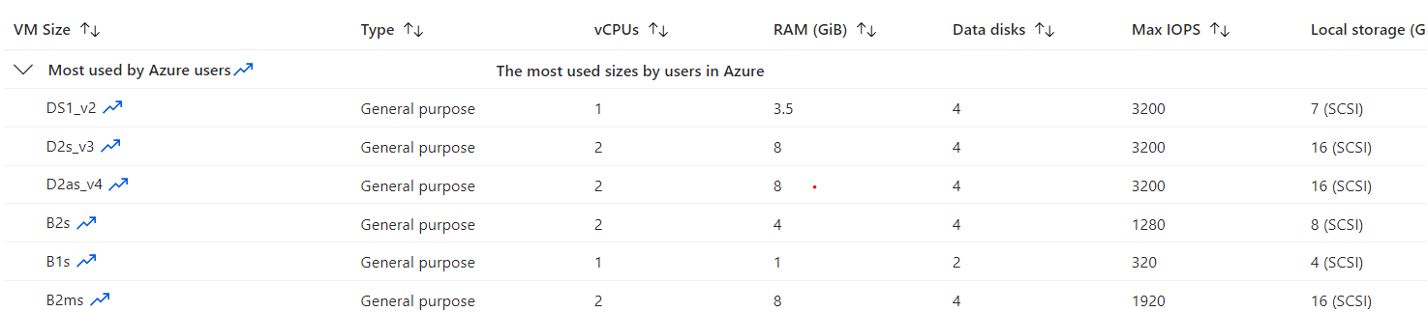
Vertical Scaling

Slide 7
Vertical Scaling

Slide 8
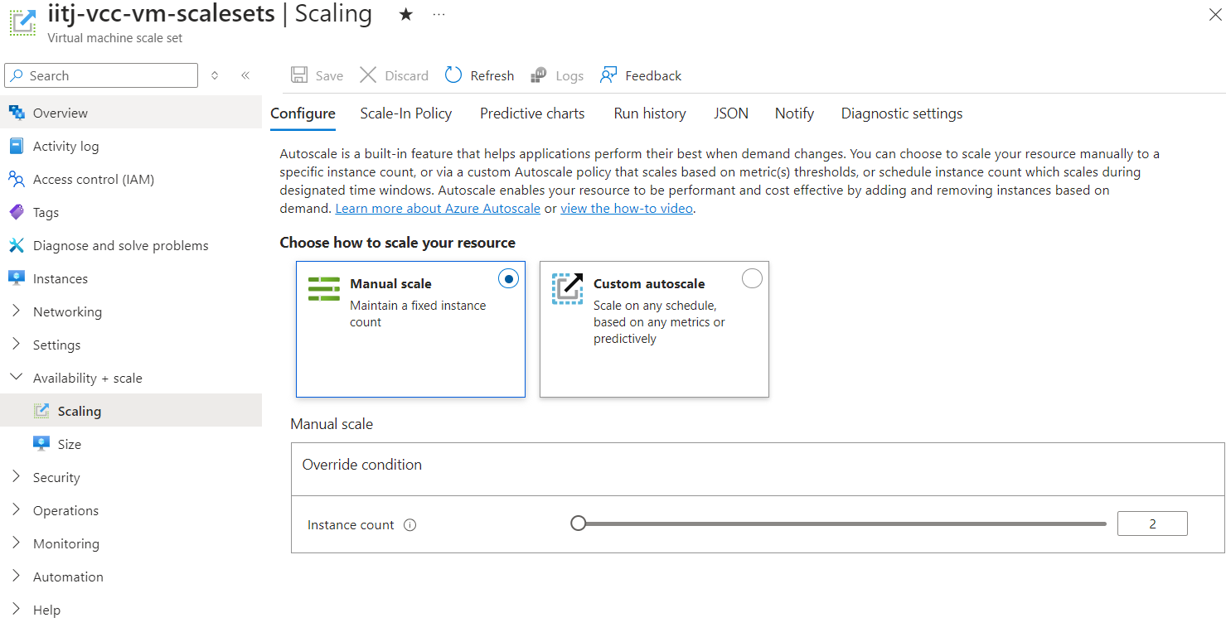
Horizontal Scaling

Slide 9
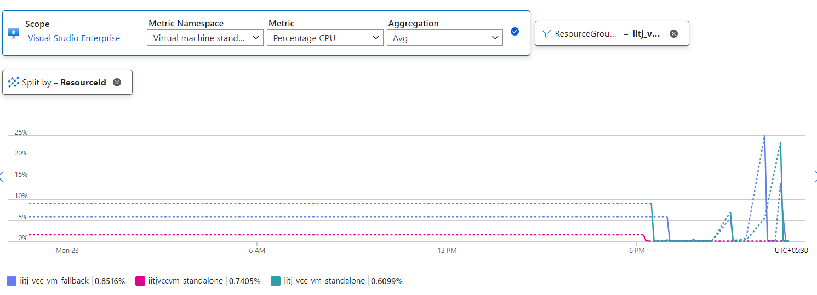
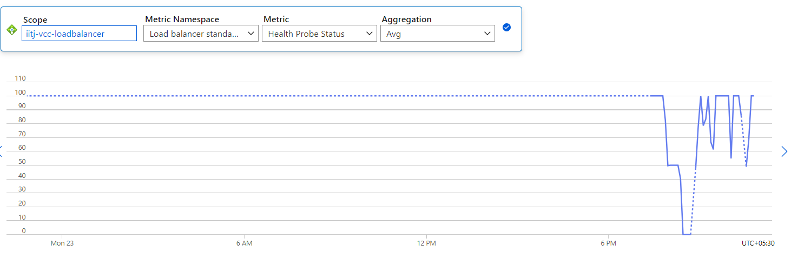
Monitoring

